Slide 1
Hadoop InputFormat, OutputFormat, and Writable class hierarchy
CSC 4760 / 6760 Big Data Programming
Spring 2018
Chapter 1 Design Patterns and MapReduce. Book: MapReduce Design Patterns, Donald Miner & Adam Shook, 2012.
Hadoop: the Definitive Guide. 2009.
https://autofei.wordpress.com/2010/06/27/oreilly-hadoop-the-definitive-guide-06-2009/

Slide 2
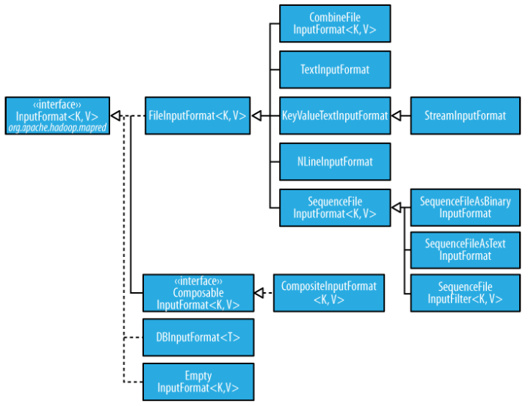
InputFormat class hierarchy
default
Your own class

Slide 3
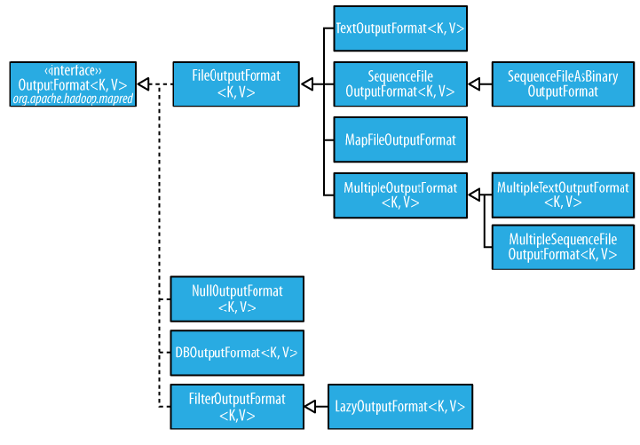
OutputFormat class hierarchy
default

Slide 4
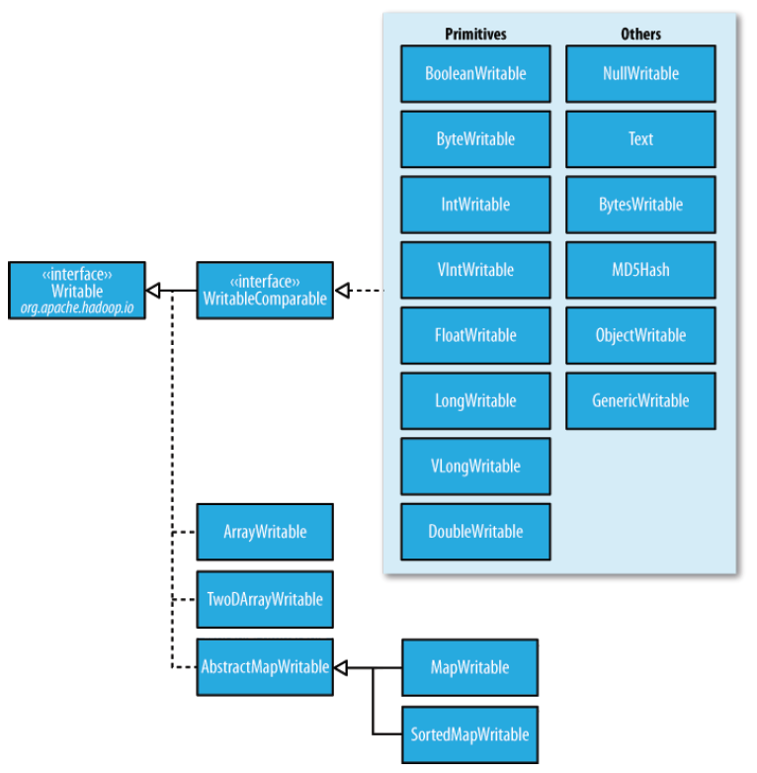
Writable class hierarchy

